Slide 1
April 17, 2014
MATH 323
Graph Theory
Cr. 3
Lecture 4
Prof. Dr. Bhadra Man Tuladhar

Slide 2
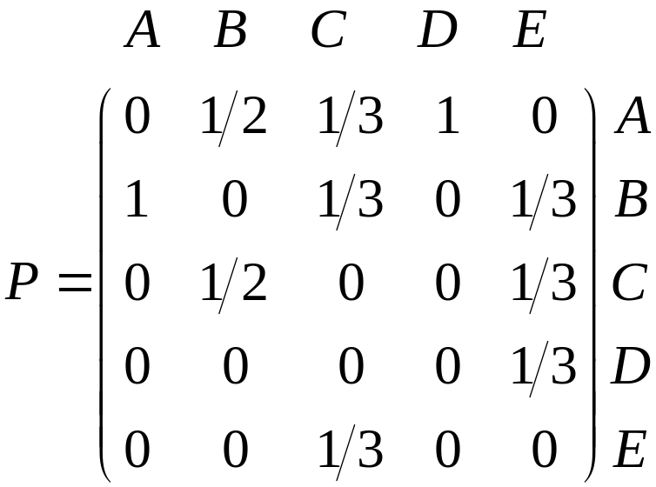

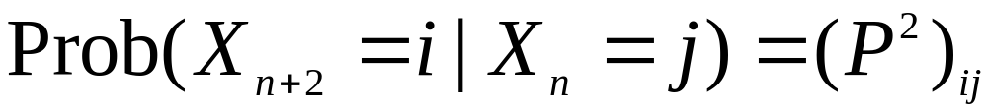
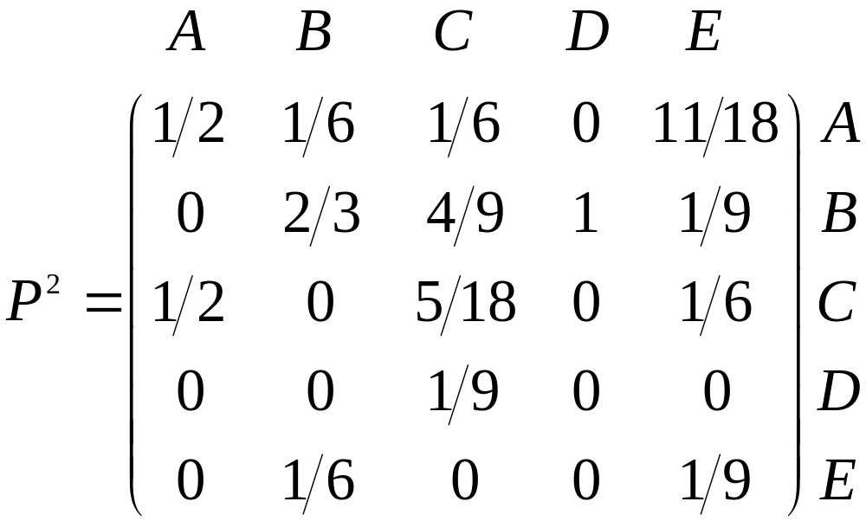
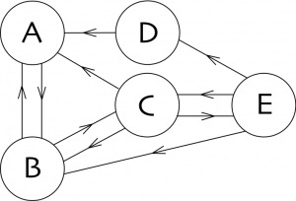
Random Walk

Slide 3
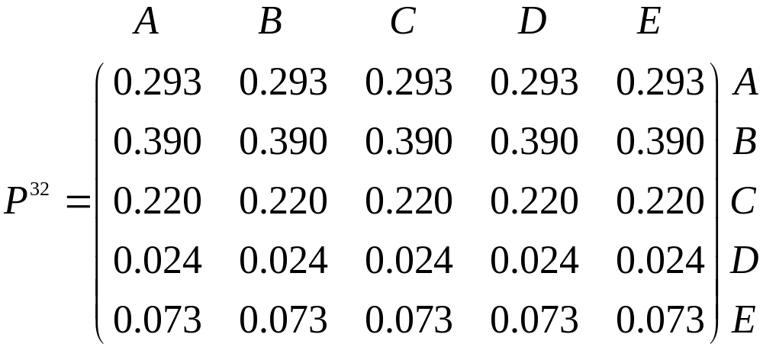
Random Walk
P³²?

Slide 4
Random Walk
All columns of P³² are identical if we choose precision to 3 decimals.
The same as the columns of P^{n} when n > 32.
If we choose a higher precision, we also find stabilization, but for n larger than 32.
After n steps, where n is sufficiently large, the probability of being on a page is independent from where we started.

Slide 5
Random Walk
Let us consider the transpose of the column vector.
Vector π is called the stationary distribution.
This stationary distribution allows to order the pages.

Slide 6
Random Walk
Let us consider the transpose of the column vector.
A
B
C
E
D
II
I
III
V
IV
In this example, we order the pages as B, A, C, D, E, and we declare B the most important page.

Slide 7
K-cube (Hypercube)
Let k ≥ 1. Consider the set B^{k} of all binary sequences of length k. For instance, B³ = {000; 001; 010; 100; 011; 101; 110; 111}. Let Q^{k} be the
graph (called the k-cube) with V(Q^{k}) = B^{k} , where uv ∈E(Q^{k}) if and only if the sequences u and v differ in exactly one place.
010
110
K-cube is an architecture for parallel computers, processing units can communicate directly if they correspond to adjacent vertices in Q_{k}.
011
111
Q^{k}
001
101
000
100

Slide 8
What kind of graph is k-cube?
The k-cube is bipartite.
The weight of a 0,1-vector is the number of 1’s. Every edge of Q^{k} consists of a vector of even weight and a vector of odd weight. Hence the vectors of even weight form an independent set, as do the vectors of odd weight.

Slide 9
What kind of graph is k-cube?
The k-cube is k-regular.
For each binary sequence i₁i₂ …i_{k}, there are k sequences that differ from this in one place. It is not dificult to verify that, V(Q^{k}) = 2^{k} and E(Q^{k}) = k. 2^{k-1}.

Slide 10
Examples
  1. For the given graph, find:
  a. Degree and parity of each vertex
  b. Verify the theorem on degree of vertices & number of edges.
v₂
v₁
v₃
v₅
v₄

Slide 11
Exercise (Contd.)
2. Draw the graphs:
a. K₈ and K_{3,5}
b. 3-regular with 7 vertices
3. Find all the paths from a to e in the graph given below:
d
b
c
e
a
g
f

Slide 12
Exercise (Contd.)
Find a 4-regular graph G that has the
following graph as an induced subgraph.

Slide 13
Exercise (Contd.)
5. Are these two graphs isomorphic?
h₆
h₅
v₃
v₁
v₄
v₅
h₁
h₃
v₆
v₂
h₄
h₂
G
H
6. Find all automorphisms of the graph G.

Slide 14
Exercise (Contd.)
7. Qualify the following two graphs:
b
1
5
a
c
2
4
3
e
d

Slide 15
Exercise (Contd.)
8. Suppose there are 6 chemicals c₁, c₂, … , c₆ some of which react with each other, if put in the same container:
c₁ reacts with c₂ and c₄, c₂ reacts with c₁ and c₆,
c₃ reacts with c_{4,} c₅ and c₆, c₄ reacts with c₁ and c₃,
c₅ reacts with c₃, c₆ reacts with c₂ and c₃.
What is the least number of containers you need in order to transport the chemicals safely?

Slide 16
Tree
A graph is called acyclic, if it has no cycles.
A tree is a connected acyclic graph.
A vertex of degree in a tree is called a leaf.
A forest is a collection of one or more trees.

Slide 17
Example of Tree

Slide 18
Theorem on Tree
Let |V| = n. There are n^{n-2} trees on V.
[Cayley (1889)]
There are only a few trees up to isomorphism:
n | 1 | 2 | 3 | 4 | 5 | 6
trees | 1 | 1 | 1 | 2 | 3 | 6

Slide 19
Trees of order 6 or less
1
2
3
4
5
6

Slide 20
Exercise
1. Draw all trees of order 7.
2. Draw all forests of order 6.

Slide 21
Some theorems
1. A connected graph is a tree if and only if all its edges are bridges.

Slide 22
Some theorems
2. If T is a tree of order n, then T has n-1 edges.
+
•
y
x
+
x•(y+z)+y
y
z

Slide 23
Some theorems
3. A graph of order n is a tree if and only if it is connected and contains n-1 edges.

Slide 24
Spanning Trees
A spanning tree of a graph G is a subgraph of G that is a tree and that consists of all the vertices of G.
Spanning Tree
G

Slide 25
Exercise
Draw all the spanning trees of the graph:

Slide 26
Weighted Graph
Let G^{α} be an edge weighted graph, that is, G^{α} is a graph G together with a weight function α : E(G) → ℜ on its edges.
3
1
2
1
7
3
H

Slide 27
Minimal Spanning Tree
Let G^{α} be a connected weighted graph. A minimal spanning tree for G^{α} is a spanning tree T which is the smallest possible weight in the sense that if T´ is any other spanning tree, then
w(T) ≤ w(T´)

Slide 28
Spanning trees of H
Graph H (on page 55) have only two spanning trees:
3
3
2
2
1
2
1
7
3
3
H₂
H₃

Slide 29

NEXT
Tress (contd.)

